Slide 1
Best “Drag Race” S7-S12 Runway Look
Great Pop Culture Debate

Slide 2
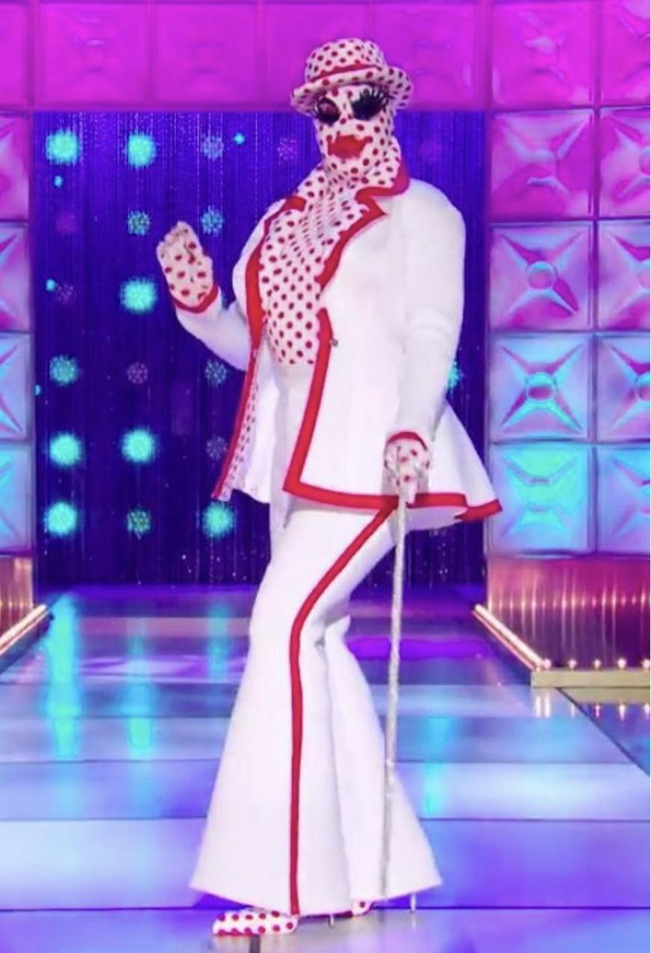
Match-Up 1:
Nina West “Facekini” vs. Miss Fame “Green”

Slide 3
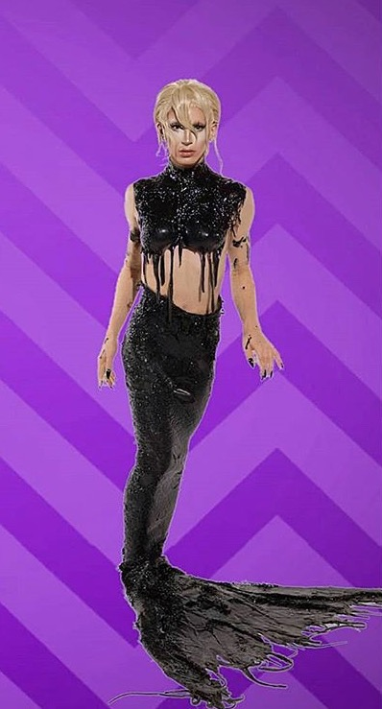
Match-Up 2:
Valentina “1,000 Madonnas V2” vs. Aquaria “Mermaid Fantasy”

Slide 4
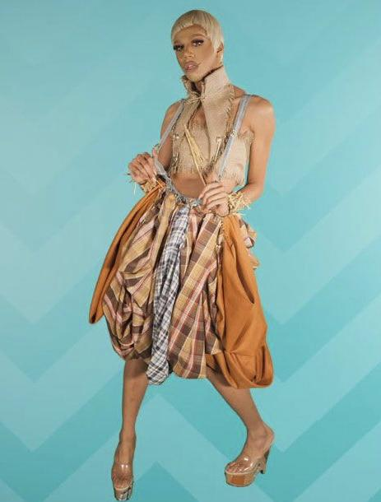
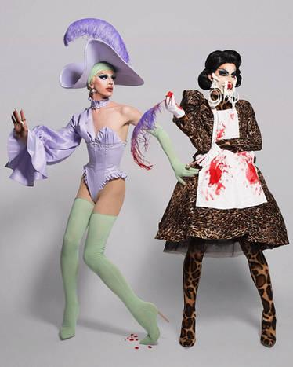
Match-Up 3:
Naomi Smalls “Wizards of Drag” vs. Aquaria “Double Trouble”

Slide 5
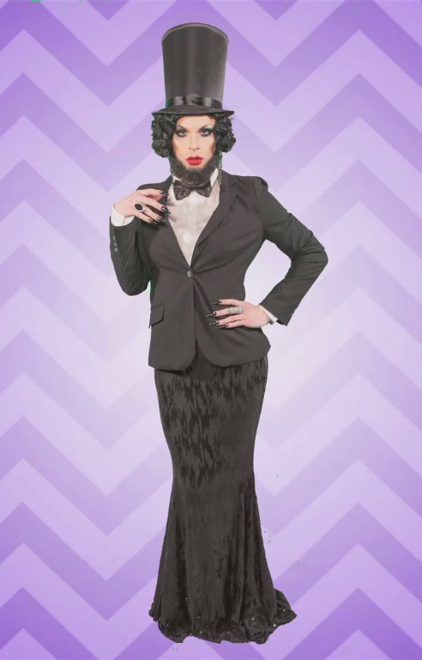
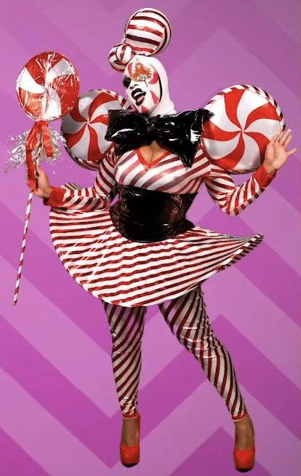
Match-Up 4:
Katya “Bearded & Beautiful” vs. Peppermint “Club Kid”

Slide 6
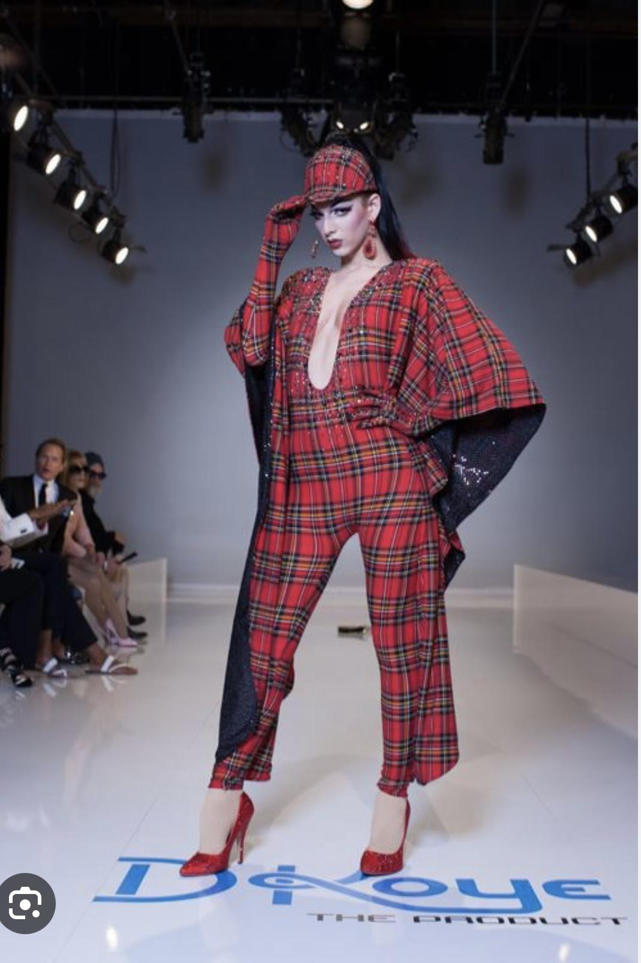
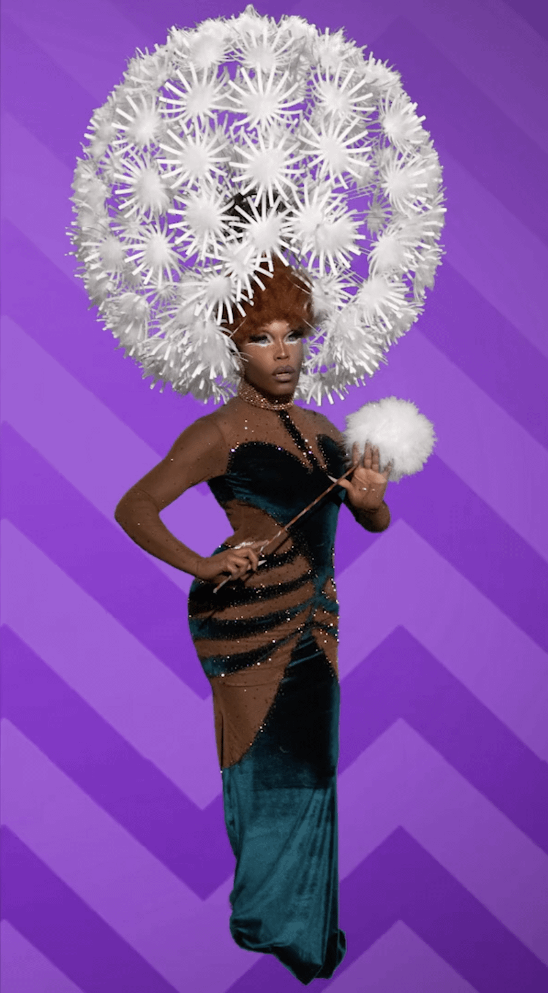
Match-Up 5:
Violet Chachki “Fall Look” vs. Asia O’Hara “Hats Incredible”

Slide 7
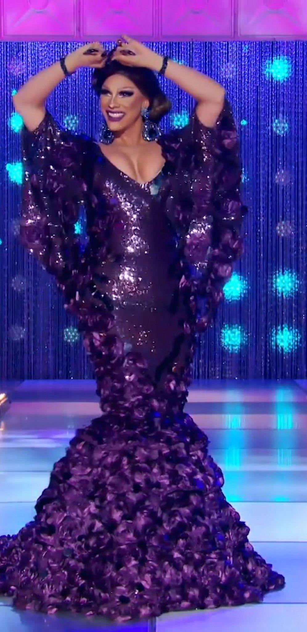
Match-Up 6:
Crystal Methyd “Fall Look” vs. Shuga Cain “Sequins on the Runway”

Slide 8
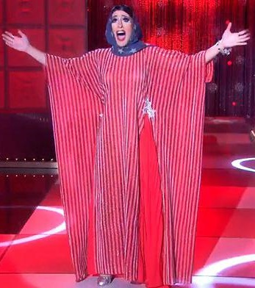
Match-Up 7:
Shea Coulee “Village People” vs. Jackie Cox “Stars & Stripes”

Slide 9
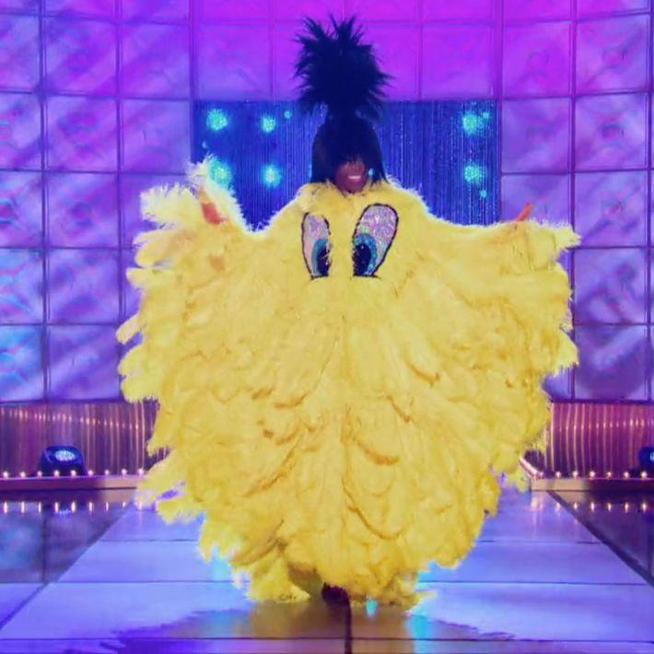
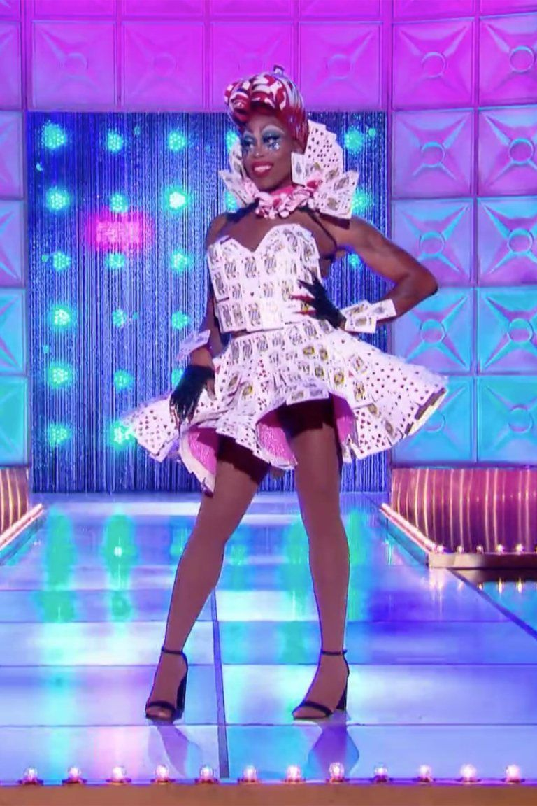
Match-Up 8:
Asia O’Hara “Feathers” vs. Mo Heart “Drag on a Dime”

